Slide 1
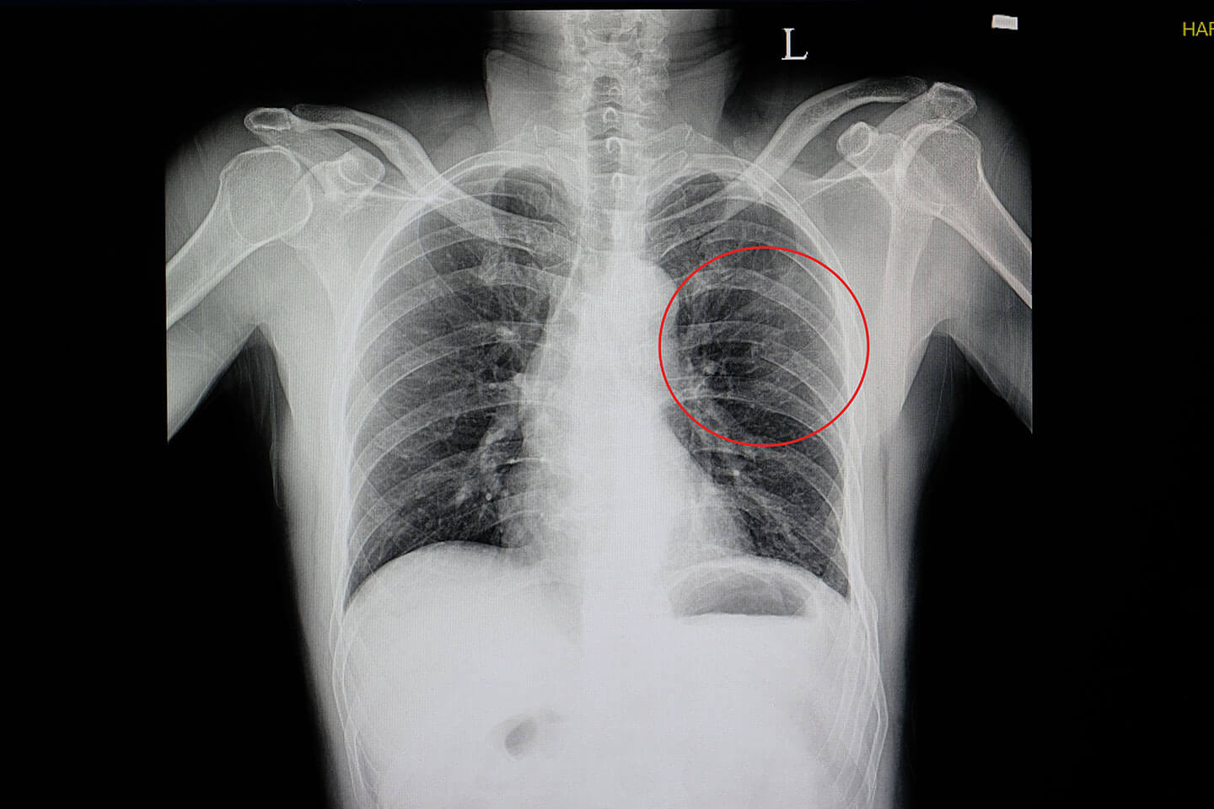
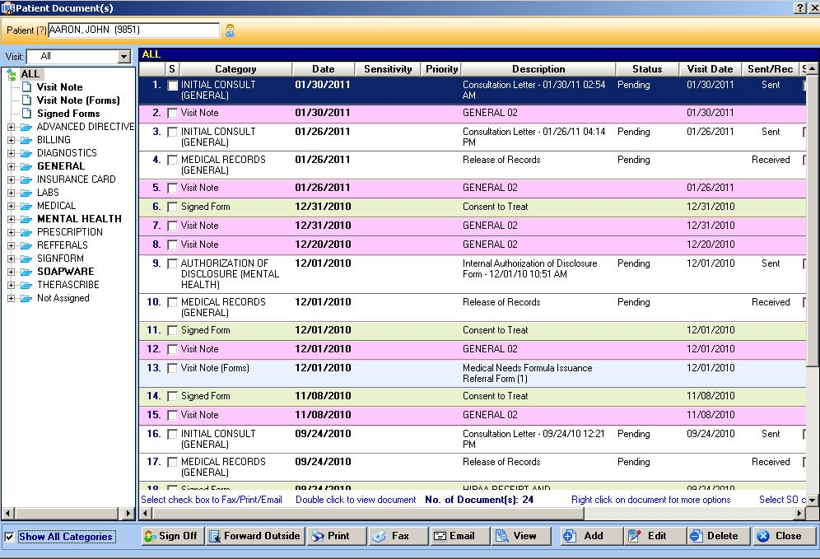
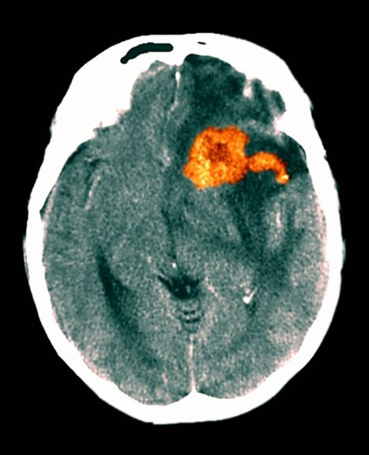
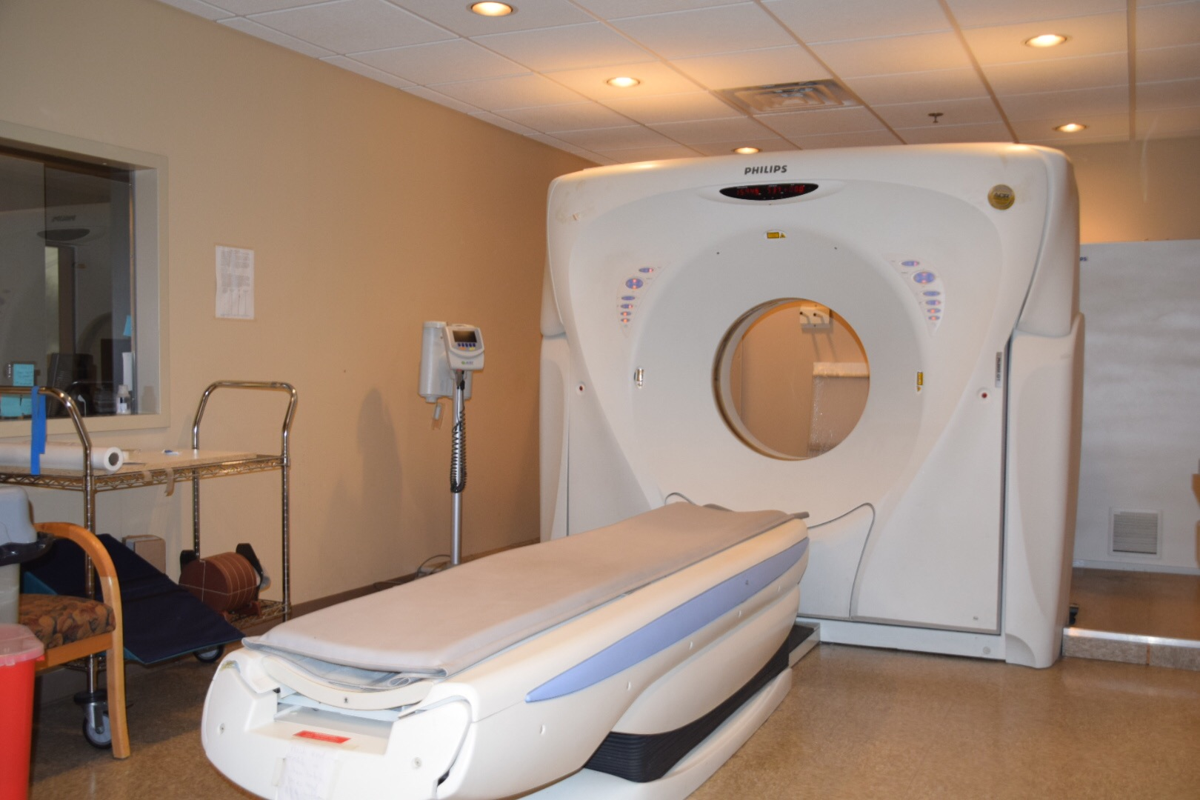
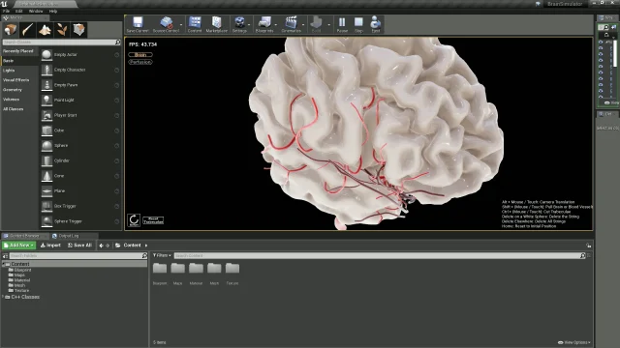

TECHNOLOGY IN HEALTHCARE
Very useful, but there are still some risks to be aware of!
Medical Imaging
Patient Records
X-Rays: Bone structure scans. Takes around 10-15 minutes; results in 10 minutes.
EHR. Includes basic info and medical history.
Source: alexanderorthopaedics.com
Sources: bing.com, nhs.uk
Zoomed image shows a rib break.
Source: bbc.co.uk
CT: Shows internal structures.
Diagnoses blood flow problems, cancer, stroke
If the tool stops working, a backup will be used.
Source: abidss.com
Source: medanets.com
Source: dzone.com
Otherwise, it will be reobtained from the patient, and recorded on paper to be copied later.
Orange represents a brain tumour
CT machine
Source: pdirad.com
Give warnings or errors before going down. E.g, X-Ray tubes should be replaced every few years.
Source: technicalprospects.com
Security
Source: nhs.uk
In some countries/private healthcare etc, financial information may be obtained from the patient (e.g. for insurance
Simulation technology may be used: research/skill practice/modelling.
Use of electronic prescriptions is becoming increasingly widespread. They are also sometimes available to the patient at home/remotely.
Source: elearningindustry.com
Source: safensoft.com
Source: nhs.uk
Simulation of a brain surgery
Source: engineering.com

Slide 2

TECHNOLOGY IN HEALTHCARE
More information about the risks
Medical Imaging
Patient Records
Increase cost for the establishment.
Maintenance/repairs required.
Paper backup (electricity) may be out-of-date
Delays in treatment.
Missing information – patients under stress.
Radiation risk
Security
Simulation
Financial risk
Intern training
Helps the environment ☺
Practice surgeries
Prescriptions are more accessible.
May be easier to read.
Aid in research
Only as good as the programmer
Unsecured devices – confidentiality breach.
May be too costly
Notes:
If the machines go down, especially on a busy day, more patients’ health will be impacted. For non-emergency scans, such as cancer MRIs, these may be pushed to a later date. With the current pandemic, this even further exacerbates the wait, and by the time the new appointment date arrives, the illness may have spread much further. This could potentially significantly decrease chances of survival, or limit the ability to perform less invasive (and therefore less risky) surgeries.
Things to consider before a CT scan include patient pregnancy – which is something that can’t be easily changed or worked around – and certain medications. In this case, an alternative may be used – for example, a more focused MRI machine so less of the patient’s body is directly exposed, or an ultrasound.
The radiation concern has been decreasing over time, for example newer models of machines emit less radiation (source: healthline.com). The radiation amount can also be adjusted, i.e. smaller sized patients will require less radiation to create a good image. The technician may also … Fun fact, an average abdomical CT scan emits roughly the same amount of radiation as 3 years of natural background radiation (e.g. from rocks, air, soil).

Slide 3
TECHNOLOGY IN HEALTHCARE
More information about the risks
Medical Imaging
Patient Records
Could be an extra cost for the establishment. May fail unexpectedly, in which case other patients may also be affected since the remaining machines will have to compensate. Delays may cause health to deteriorate further.
Backup may be out of date or poorly recorded.
Patient/their families may miss things out since they are under stress
CT relies on radiation – there are precautions in place, but there is still a (small) possibility of there still being some risk, particularly in the event of a malfunction.
Security
If there is any hacking, the patients’ bank information could be left vulnerable to attack. This could also potentially mean the treatment could no longer be afforded.
Simulation
This can be used to assist teaching interns, and to practice long surgeries on a ‘living’ structure before trying it on the actual patient.
This helps with the environment, as well as increasing convenience. Prescriptions are less likely to be lost.
However, making prescriptions more accessible leaves them more open to attack, especially on unsecured devices. Additionally, some patients may not often use their phone/be comfortable with technology, so the benefit may be less pronounced when compared with the cost.
Notes:
If the machines go down, especially on a busy day, more patients’ health will be impacted. For non-emergency scans, such as cancer MRIs, these may be pushed to a later date. With the current pandemic, this even further exacerbates the wait, and by the time the new appointment date arrives, the illness may have spread much further. This could potentially significantly decrease chances of survival, or limit the ability to perform less invasive (and therefore less risky) surgeries.
Things to consider before a CT scan include patient pregnancy – which is something that can’t be easily changed or worked around – and certain medications. In this case, an alternative may be used – for example, a more focused MRI machine so less of the patient’s body is directly exposed, or an ultrasound.
The radiation concern has been decreasing over time, for example newer models of machines emit less radiation (source: healthline.com). The radiation amount can also be adjusted, i.e. smaller sized patients will require less radiation to create a good image. The technician may also … Fun fact, an average abdomical CT scan emits roughly the same amount of radiation as 3 years of natural background radiation (e.g. from rocks, air, soil).

